Slide 1
The best arrondissement for tourists in Paris
Camilla Bragança
February, 9th, 2021

Slide 2

Introduction
Paris is the most visited city in the whole world. Many tourists love it and many end up hating it!
Being a multicultural city with each arrondissements having it's all peculiar characteristics. The ancient old question arise for every tourist planning to visit Paris, "Where should I stay?".
The present report aims to analyzing the diversity of each arrondissement. Leaving a better notion of where should tourists choose to stay accordingly to their preferences.

Slide 3



Business Problem
Paris is a big city and each arrondissements have different characteristics. A tourist that have never been to Paris faces the dilemma of which arrondissements should they stay.

Slide 4

Data description
Geolocation data for Paris was obtained at https://www.data.gouv.fr/fr/datasets/r/e88c6fda-1d09-42a0-a069-606d3259114e
Postal codes of the city serve as a starting point. Using postal codes it's possible to find out the arrondissement, venues and their most popular venues categories.
The JSON file has data about all the cities in France, in the assignment the city of Paris was limited so its arrondissement could be accessed and analyzed.

Slide 5
Methodology
Installing and importing Packages
Data collection
Data cleaning
Data processing
Visualizing the map of Paris
Model Building (K means)
Visualizing the clustered arrondissements

Slide 6
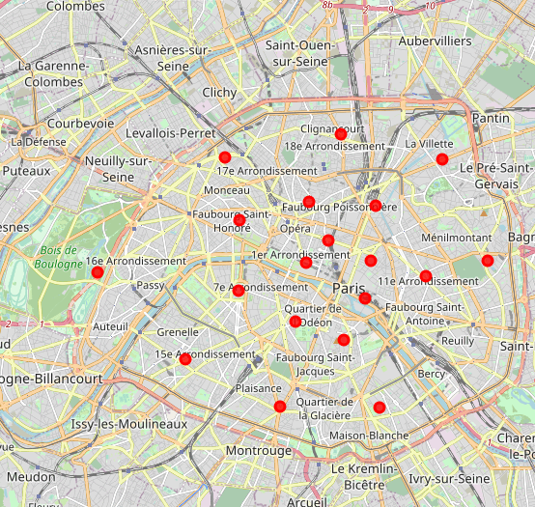
Results
Paris Map

Slide 7
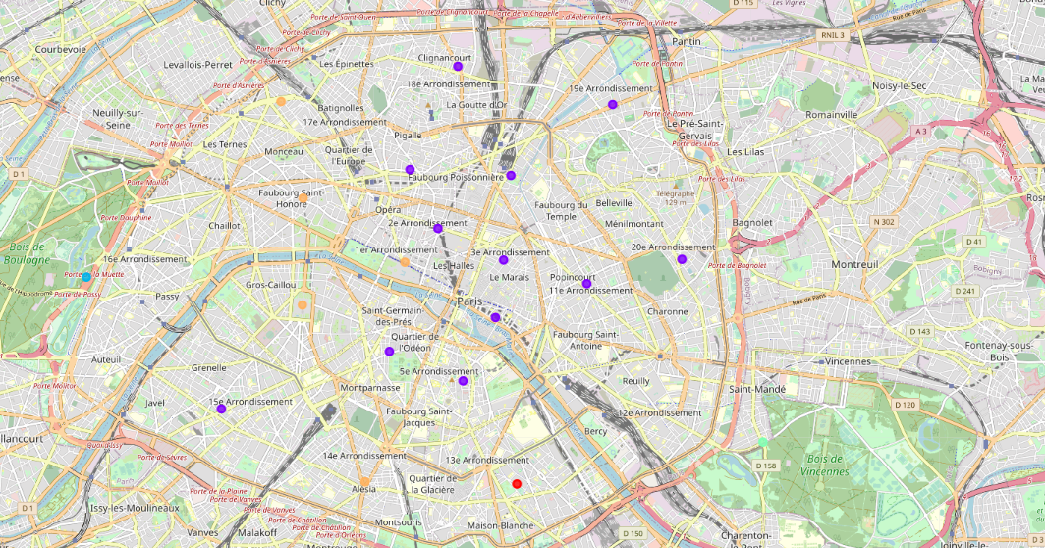
Results
Paris map segregated by clusters

Slide 8
Discussion
Paris is a lively city. It has a wide variety of restaurants of different cuisines. There are a lot of places to go and have some fun such as restaurants and Bars. Paris seems like a great city for tourists to visit with all its museums, parks, art galleries and history. Paris seems as a multicultural city with lot of spots to go and have amusing trip.
If a tourist plans for a calm vacation with a lot of site seeing is better that he/she stays at the 16 arrondissement. On the other hand, If the tourist wants to be around many bars, and French restaurants he/she should stay at arrondissements: 1 - 6, 9 - 11, 15, 18 -20. If the tourist has a strong preference for Asian food he/she would prefer to stay at the 13 arrondissement.

Slide 9
Conclusion
Paris is a great city for tourists to visit with a lot of things to do and places to go. The cuisine is rich and multiverse, making it impossible to don't find something to the tourist taste. Overall, Paris holds the title of the most visited city by tourists in the world for a great reason, all it's arrondissements present great options for diverse preferences.

